Slide 1
CS118 – Programming Fundamentals
Lecture # 02
Tuesday, August 20, 2019
FALL 2019
FAST – NUCES, Faisalabad Campus
Tahir Farooq

Slide 2
Algorithms and Problem Solving Techniques

Slide 3
Basic Concepts of Problem Solving
Computer programming is traditionally thought of as problem-solving process.
A computer program is a solution to a problem
Computer program: The computer program is a set of instructions that tells the computer hardware what to do and when to do it
There are two parts to develop computer programs, the algorithm and the syntax
Algorithm: The programs algorithm is the development of step-by-step, logical process that the program will follow to reach the desired goal of the program (the solution)
Syntax : It is the rule of the programming language which dictate proper statement structure and usage
Notes:
What and when

Slide 4
Basic Concepts of Problem Solving
Documenting the algorithm can be done by using flowcharts, pseudocode or other visual tools such as Nassi-shneiderman, unified modeling language (UML), or other algorithm representations
Structure charts (also known as hierarchy charts) can be used to show the relationship in a pre-defined process
The syntax of the program is writing the actual programming code in a selected programming language

Slide 5
The problem-solving process
There are several steps in the program development cycle
Program development cycle consists of five steps
Analyze the Problem
Plan the Solution
Code the Program
Test
Implementation/Deployment and maintain

Slide 6
The problem-solving process
Analyze the problem : Programmer determines
What the program is supposed to do (the purpose of the program)
What data the program will use ( the programs input); what the program is supposed to produce (the programs output); the process the program will use to transform the data into the desired output information
Visual tools for this stage can include
Input layout charts that represent how the input data is stored in the records of a file or how input prompt will appear on the screen
Output layout spacing charts represent what the finished output report or screen will look like

Slide 7
The problem-solving process …
Plan the solution : During the planning stage of the programming development cycle, the programmer utilizes visual tools such as flow charts, pseudocode and hierarchy charts to develop the programs algorithm, or solution to the problem
A flow chart is a graphical representation step-by-step that shows the flow of control of the program using symbolic diagrams.
Pseudocode is a visual representation of the same step-by-step logic, but pseudocode is English–like phrases instead of symbols
Hierarchy (or structure) charts show the major operational tasks required for the program solution. In addition, the charts demonstrate the relation ships between each of the major sections
Once the algorithm has been documented using one or more of the visual tools, the programmer checks the programs logic by stepping through the algorithm with realistic test data
At this point the logic errors may be detected and corrected
Notes:
checks the programs logic by stepping through the algorithm with realistic test data
At this point the logic errors may be detected and corrected

Slide 8
The problem-solving process …
Code the program: The program (or source) code is written in the programming language selected by the programmer following the rules (or syntax) for that language
Once the source code is written
The program is processed by the language translator program
Any syntax errors are detected by the translator must be corrected before the machine language (object) can be generated
When all debugging and syntax errors is complete, a run-time version of the program can be executed
Language translator: A language translator converts human-readable source code statements into the machine- readable object code; depending on the language, the translator will be an assembler, interpreter, or compiler program
Notes:
Obj
Exe

Slide 9
The problem-solving process …
Test: Testing the program is done using sets of data designed to produce the expected results
If the program language is faulty, the desired results will not be produced
The programmer must then debug the source code and revise the logic in the planning stages
This stage should require minimal effort
Debug and revise: To debug a program, the programmer finds and corrects syntax errors in the source code
Notes:
2+2=4
If error revise planning → logic

Slide 10
The problem-solving process …
Implementation/Deployment and maintain: The final stages of the programming process is to put the program into production
At this stage, all program documentation must be completed and presented at the time the program is implemented
The documentation includes all the documents used in the planning stage (such as input, output charts). The printed source code also becomes a part of the documentation
In addition, user training manuals are provided as well as any other information that the end user might require to properly run the program
Maintaining the program includes making appropriate updates to the program as needed
For instance, if income tax rates change, an update to the tax amounts would be required for a payroll program
Notes:
Documentation
printed source code

Slide 11
The problem-solving process …
Analyze the problem
Plan the solution
Code the program
Test
Implement and maintain

Slide 12
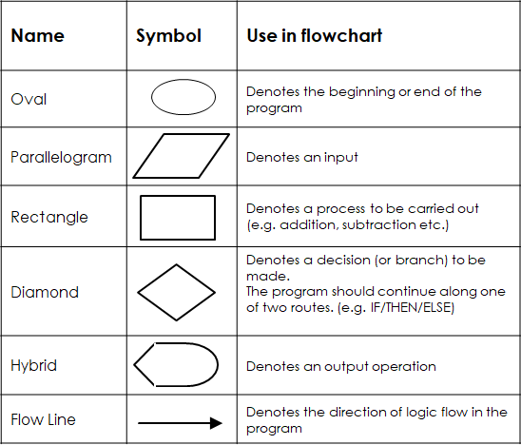
Flowcharts and Pseudocodes
Flowcharts are graphical representations of the programs’ algorithm
Standard flowcharting symbols represent the beginning, the end and the control structure within the program that direct the flow chart or the Programs logic
The symbols are connected using flow lines that illustrate the flow of control thought the program →
Pseudocode: is an informal English-like representation of the programs algorithm. Pseudocode is written more like the actual code that will be used to write the program.

Slide 13
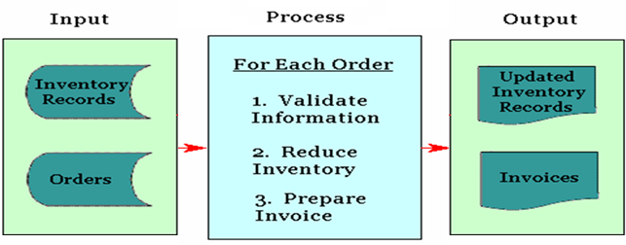
Input-Process-Output (IPO) Charts
The Input-Process-Output (IPO) chart list the programs input data, processes and outputs
IPO charts: are used to clearly define the inputs, process and outputs to be used in program
Input: The data or information the program will use to produce the output
Process: The steps the program will follow in order to process the input into output
Output: The information produced by the program after processing the input

Slide 14
Algorithms and Flowcharts

Slide 15
Algorithms
A concept that pervades all areas of computer science
Algorithm is a process that a computer could carry out to complete a well defined task within finite time and resources
The objective of computer science is to solve problems by developing, analyzing, and implementing algorithmic solutions

Slide 16
Al-Khwarizimi Principle
All complex problems can be broken into simpler sub-problems
Solve a complex problem by breaking it down into smaller sub-problems and then solve them (in a specified order), one at a time
When all the steps are solved, the original problem itself has also been solved
This process is called Algorithm
Notes:
Muḥammad ibn Mūsā al-Khwārizmī[note 1] (Persian: c. 780 – c. 850), formerly Latinized as Algorithmi, was a Persian scholar who produced works in mathematics, astronomy, and geography under the patronage of the Caliph Al-Ma'mun of the Abbasid Caliphate

Slide 17
Divide and Conquer
Hard Problem
Easy Sub-problem
Hard Sub-problem
Easy Sub-problem
Easy Sub-problem
Easy Sub-problem

Slide 18
Steps in Problem Solving
First produce a general algorithm (one can use pseudocode)
Refine the algorithm successively to get step by step detailed algorithm that is very close to a computer language
Pseudocode is an artificial and informal language that helps programmers develop algorithms
Pseudocode is very similar to everyday English

Slide 19
Algorithms & Pseudocode
A typical programming task can be divided into two phases
Problem Solving phase:
Produce an ordered sequence of steps that describe solution of problem
This sequence of steps is called an algorithm
Implementation phase:
Implement the program in some programming language

Slide 20
Sample problem
Compare two numbers given by the user and tell which one is greater?

Slide 21
Pseudocode – Format
1. start
2. declare n1, n2
3. input n1,n2
4. if (n1 > n2)
4.1 print "n1 is greater"
5. else if (n2 > n1)
5.1 print "n2 is greater"
6. else
6.1 print "they are equal"
7. end

Slide 22
Pseudocode – Format
1. start
2. declare n1, n2
3. input n1,n2
4. While(n2 > n1)
4.1. Calculate n1 = 2 * n1;
5. end

Slide 23
Algorithms and Pseudocode
Example 1: Write an algorithm to determine a student’s final grade and indicate whether he is passing or failing. The final grade is calculated as the average of four marks.

Slide 24
Algorithms and Pseudocode
Algorithm:
Input a set of four marks
Calculate their average by summing and dividing the sum by 4
If average is above 50
Print : “Pass”
else
Print “FAIL”

Slide 25
Algorithms and Pseudocode
Pseudocode:
Step 1: Input M1, M2, M3, M4
Step 2: Grade = (M1+ M2+ M3+ M4) / 4
Step 3: if (Grade > 50) then
Print “PASS”
else
Print “FAIL”
endif

Slide 26
Pseudo-Code: Decision Making
If-then
General form:
if (condition is met) then
statement(s)
Example:
if temperature < 0 then
wear a jacket

Slide 27
Pseudo-Code: Decision Making
If-then-else
General form:
if (condition is met) then
statement(s)
else
statements(s)
Example:
if (at work) then
Dress formally
else
Dress casually

Slide 28
Pseudo-Code: Repetition (3)
while-do
Repeat zero or more times (check condition before statement(s))
General form:
while (condition is met)
statement(s)
Example:
while students ask questions
Answer questions

Slide 29
Pseudo-Code: Fast Food Example
Use pseudo-code to specify the algorithm for a person who is ordering food at a fast food restaurant
At the food counter, the person can either order or not order the following items:
a burger
fries and a drink
After placing her order the person then goes to the cashier

Slide 30
Pseudo-Code: Fast Food Example
1. Approach counter
2. if want burger then
2.1. order burger
3. if want fries then
3.1. order fries
4. if want drink then
4.1 order drink
5. Pay cashier

Slide 31
Pseudo-Code: Fast Food Example (Computer)
1. Approach counter
2. Output ‘Do you want to order burger?’
3. Input order_burger
4. if order_burger = yes then
4.1. order_burger
5. Output ‘Do you want to order fries?’
6. Input order_fries
7. if order_fries = yes then
7.1. order_fries
8. Output 'Do you want to order drink?’
9. Input order_drink
10. If order_drink = yes then
10.1. order drink
11. Pay cashier

Slide 32
Pseudo-Code: ATM Example
Use pseudo-code to specify the algorithm for an ATM bank machine. The bank machine has four options: 1) Show current balance
2) Deposit money
3) Withdraw money
4) Quit
After an option has been selected, the ATM will continue displaying the four options to the person until he selects the option to quit the ATM

Slide 33
Pseudo-Code: ATM Example
Approach ATM
Repeat
Output 'Select option'
Output '1) Make withdrawal'
Output '2) Make deposit'
Output '3) Show balance'
Output '4) Quit'
Input option
If option = deposit then
Output 'Enter amount to
deposit'
Input amount
balance ← balance + amount
If option = withdrawal then
Output 'Enter amount to withdraw'
Input amount
balance ← balance – amount
If option = ‘Show Balance’
Output 'Balance is ' balance
Until option = quit
Stop

Slide 34
Questions

